Slide 1


AUTO MVP
Facebook Marketplace Automotive Analyzer
Pietro Stolf

Slide 2
Tools Developed
Scraper
Rebuilt Tag Identifier
Price predictor
Selenium
BeautifulSoup
NLP
Logistic regression
Linear Regression

Slide 3
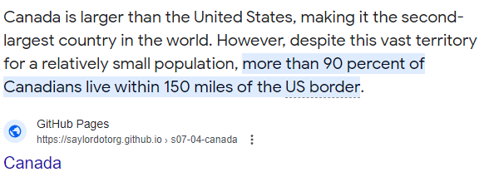
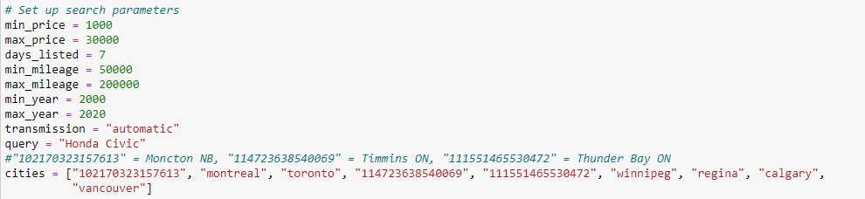
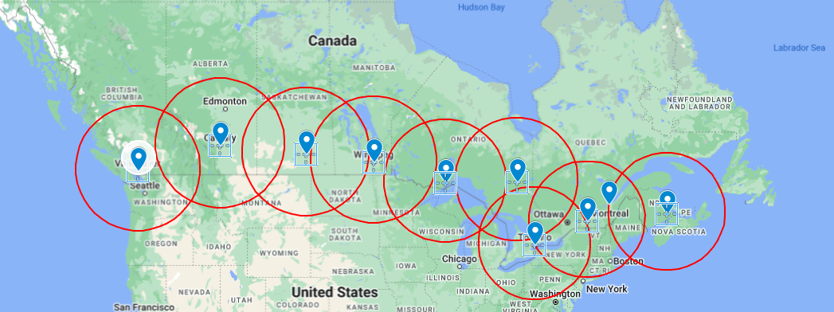
Highlights- Scraper

Slide 4
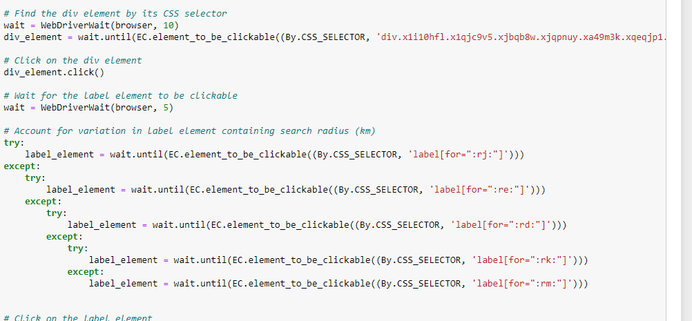

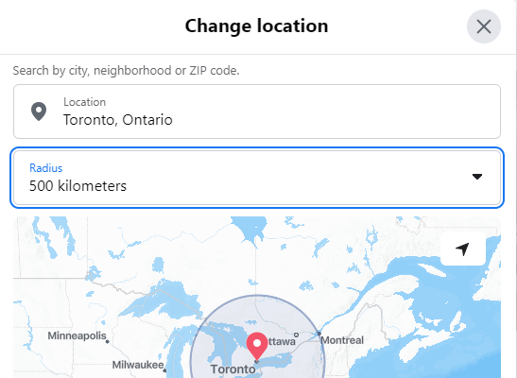
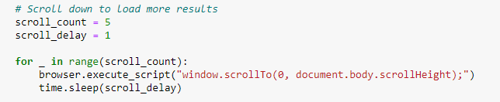
Highlights- Scraper
Dynamic DIV names
Set Radius to 500km
Scroll Down

Slide 5
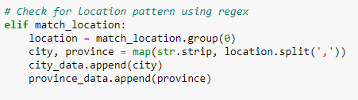

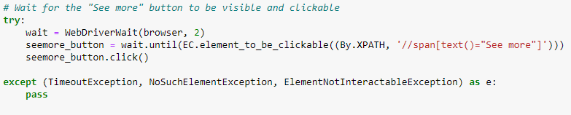

Highlights- Scraper
Regex

Slide 6
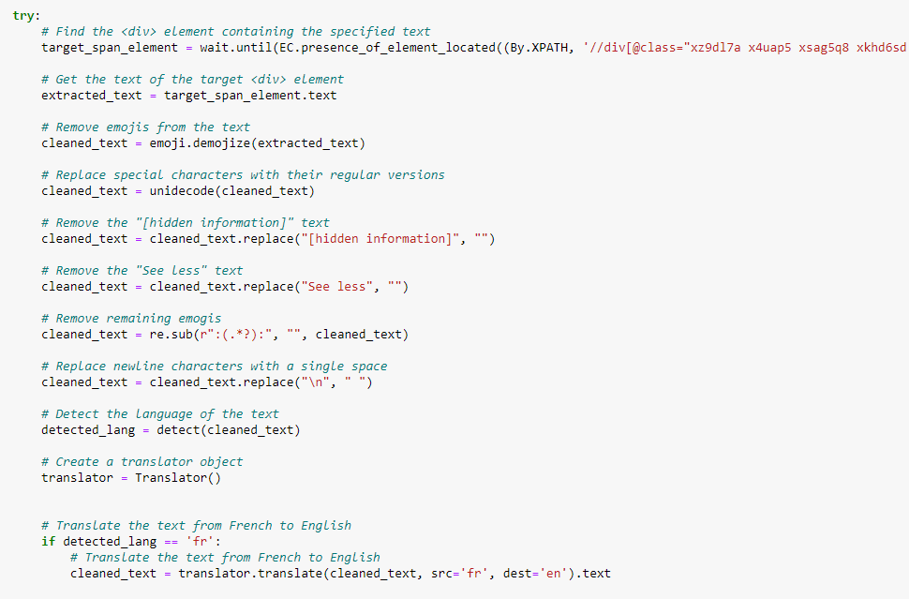
Highlights- Scraper
Oh, Canada

Slide 7

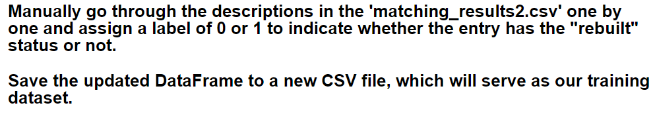
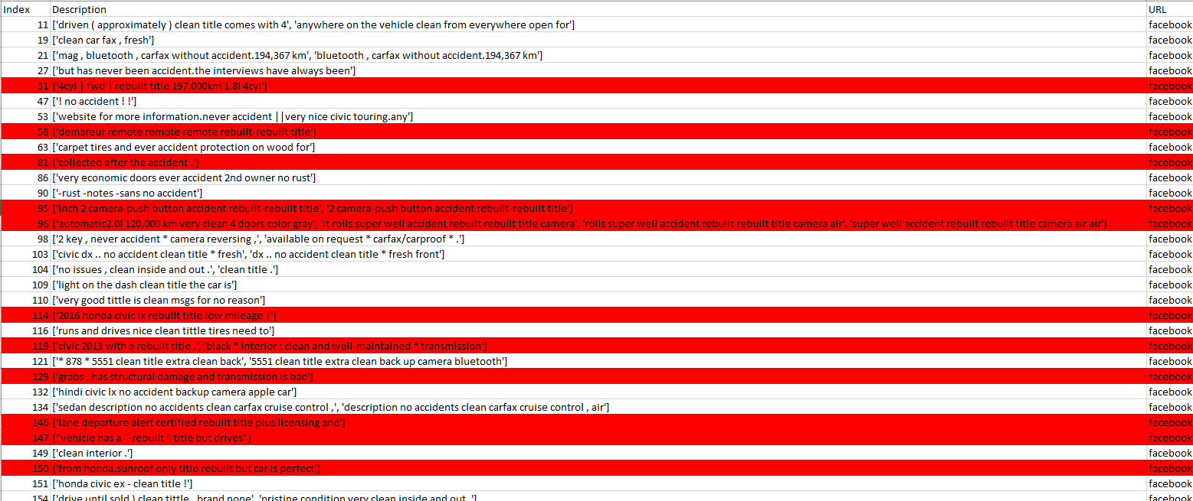
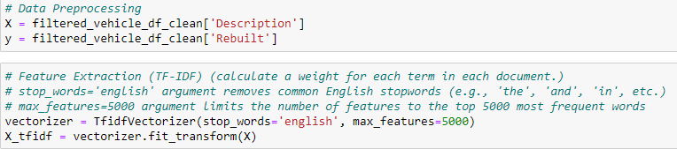
Highlights -Tag Identifier

Slide 8
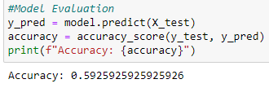
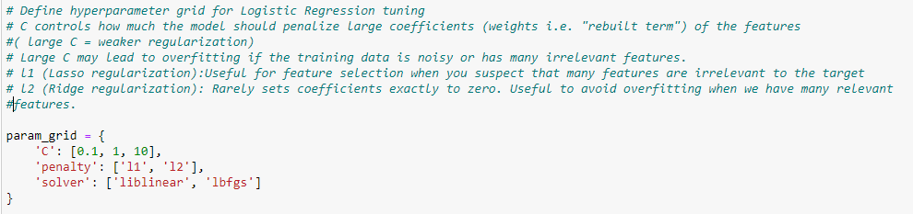
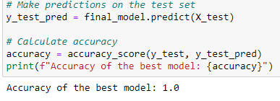
Optimization -Tag Identifier

Slide 9
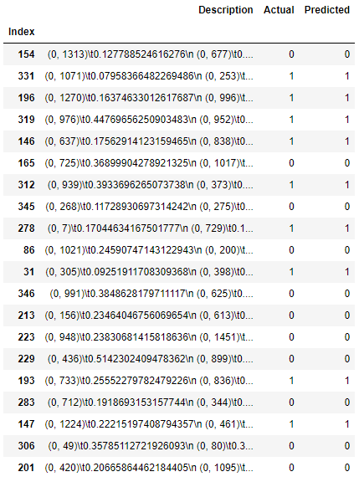
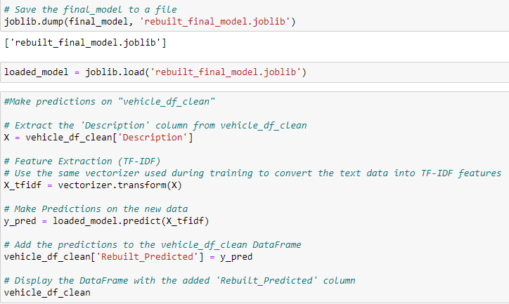
Results -Tag Identifier

Slide 10
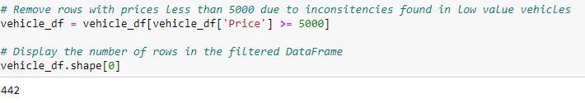
Highlights – Price Predictor
DB Connection
Price cut-off
City = Noise

Slide 11
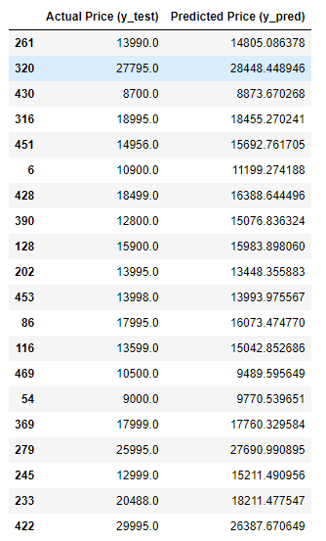

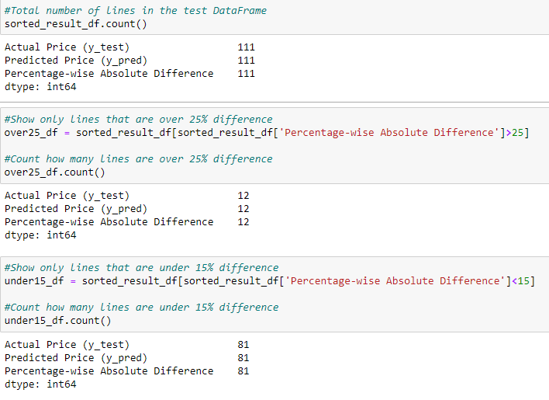
Results – Price Predictor

Slide 12
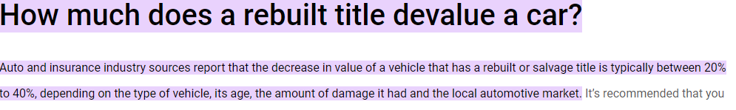


Slide 13
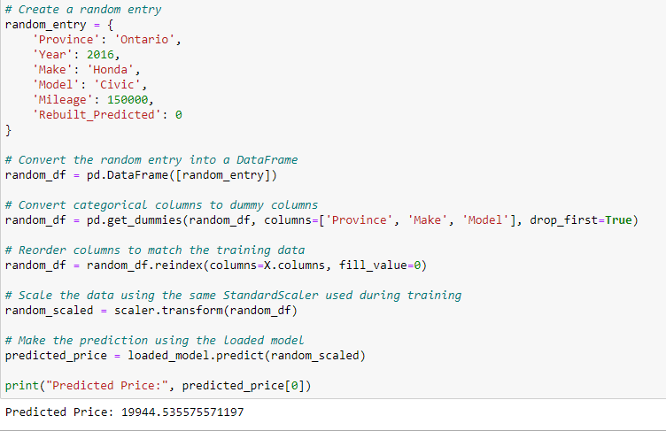
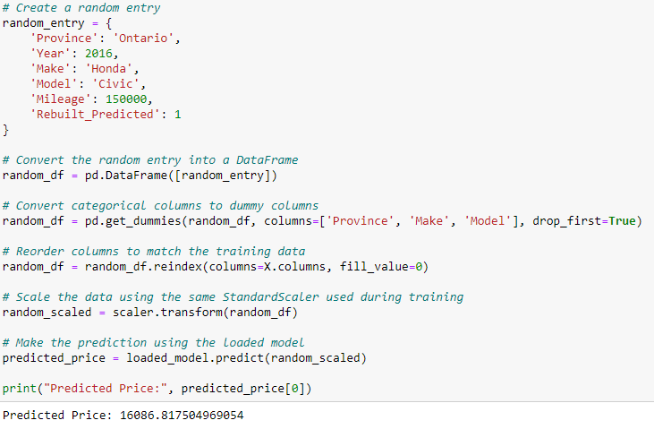
Results – Price Predictor
Rebuilt = 0
Rebuilt = 1
Predicted Price: $19944.53
Predicted Price: $16086.81
~20%

